Slide 1
Test Automation & Advanced Selenium
Lab Book Version 2.0
TEST AUTOMATION & ADVANCED SELENIUM LAB BOOK

Slide 2
TEST AUTOMATION & ADVANCED SELENIUM LAB BOOK
Table of Contents
Document Revision History ................................................................................................ 2
Table of Contents ............................................................................................................... 3
Getting Started ................................................................................................................... 4 Lab Demo 1: Example (Basic Selenium IDE Flow) ............................................................ 5
Lab Demo: Example (Selenium IDE) (Cont.) ..................................................................... 6
Lab Demo: Example (Selenium IDE) (Cont.) ..................................................................... 7
Lab Demo 2: Learning Selenium IDE (Modifications) ........................................................ 8
Lab Demo 3: Learning Selenium IDE(Basic Flow) ............................................................ 9
Lab Demo 4: Learning Selenium IDE(Performing Validations) ........................................ 10
Lab Demo 5: Create a new account (using Selenium Webdriver) .................................. 11
Lab Demo 6: Validations in Selenium (using Selenium Webdriver)................................. 13
Lab Demo 7: Alert and window handling (using Selenium Webdriver) ............................ 14 Lab Demo 8: WebDriver with JUnit/TestNG (using Selenium Webdriver with Junit and TestNG) ............................................................................................................................ 15
Lab Demo 9: Advance Selenium (Chrome Driver and IE Driver) ..................................... 16
Lab Demo 10: Advance Selenium (RemoteWebDriver)................................................... 17 Lab Demo 11: Advance Selenium (Page object Model and Page Factory) ..................... 18
Lab Demo 12: Advance Selenium (Object Repository using Properties File).................. 19 Lab Demo 13: Advance Selenium (Object Repository using XML file) ............................ 20 Lab Demo 14: Advance Selenium (Parametrization using Excel Apache POI) ............... 21 Lab Demo 15: Advance Selenium (Parameterization using CSV file) ............................ 22 Lab Demo 16: Advance Selenium (Parameterization using XML and Dataprovider in TestNG) ............................................................................................................................ 23
Appendices ....................................................................................................................... 24 Appendix A: Selenium Standards ....................................................... 24

Slide 3
TEST AUTOMATION & ADVANCED SELENIUM LAB BOOK
Getting Started
Overview
This lab book is a guided tour for learning Test Automation & Advanced Selenium. It comprises solved examples and ‘To Do’ assignments. Follow the steps provided in the solved examples and work out the ‘To Do’ assignments given.
Setup Checklist for Selenium
Here is what is expected on your machine in order for the lab to work.
Minimum System Requirements
Intel Pentium 90 or higher (P166 recommended)
Microsoft Windows 95, 98, or NT 4.0, 2k, XP.
Memory: 512MB of RAM
Internet Explorer 6.0 or higher
Mozilla Firefox( Add-ons: Firebug, Firepath, Selenium IDE)
Instructions
For all coding standards refer Appendix A. All lab assignments should refer coding standards.
Create a directory by your name in drive <drive>. In this directory, create a subdirectory Selenium_Assign. For each lab exercise create a directory as lab <lab number>.

Slide 4
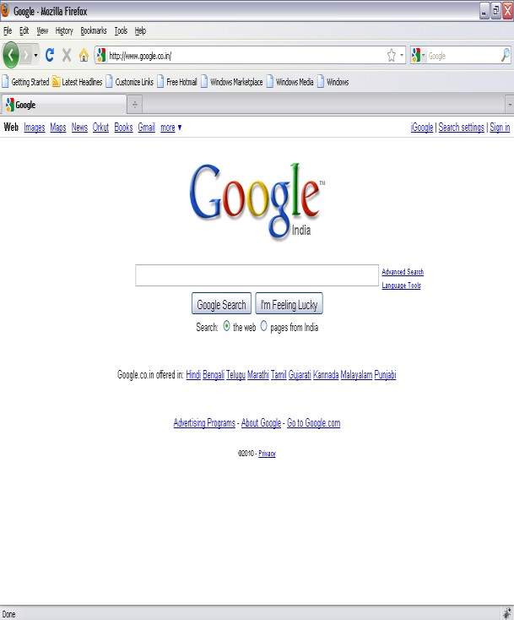
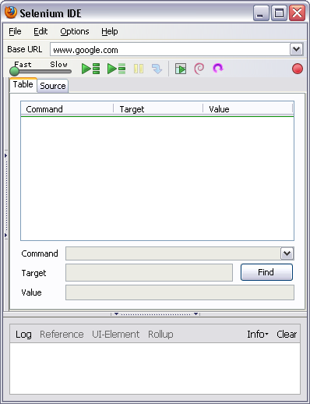
TEST AUTOMATION & ADVANCED SELENIUM LAB BOOK
Lab Demo 1: Example (Basic Selenium IDE Flow)
Goals | Understand the process of automation testing of a web application on Selenium IDE Learn to manage document spacing
Time | 60 minutes
Go to the Web Page for which you want to carry out the test
Hit the record button on IDE

Slide 5
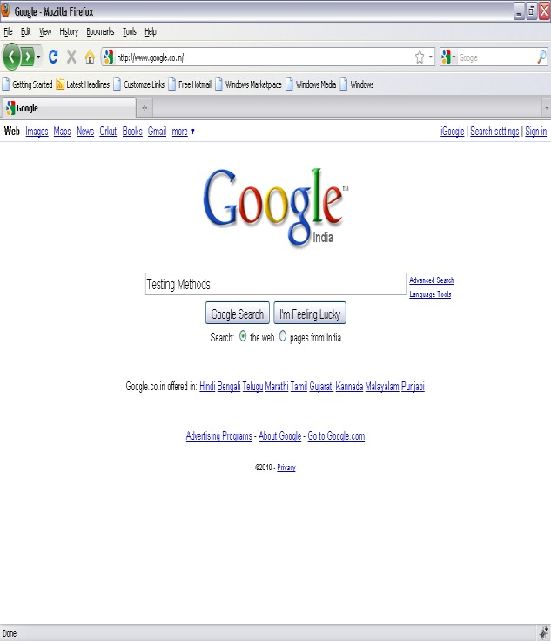
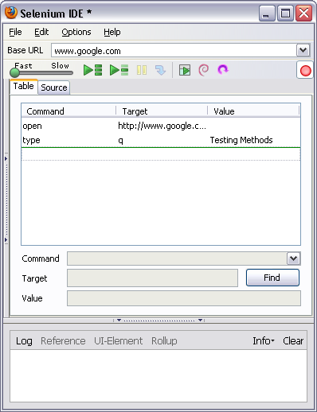
TEST AUTOMATION & ADVANCED SELENIUM LAB BOOK
Lab Demo: Example (Selenium IDE) (Cont.)
Enter the text on Web Page and submit
IDE should be updated, stop the recorder and add the assertions

Slide 6
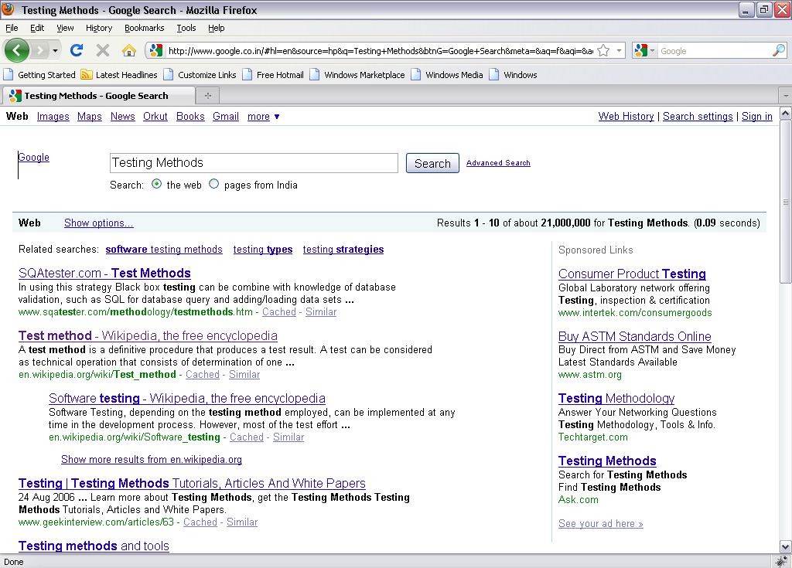
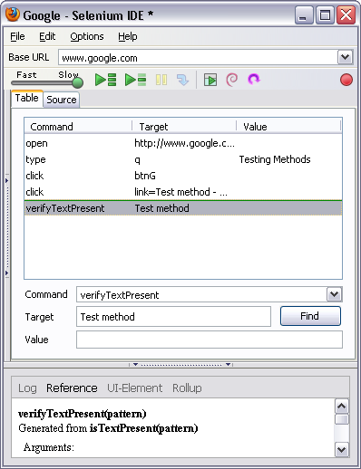
TEST AUTOMATION & ADVANCED SELENIUM LAB BOOK
Lab Demo: Example (Selenium IDE) (Cont.)
Perform operations on the web page
Play Button
Hit the play button to play the recorded scripts

Slide 7
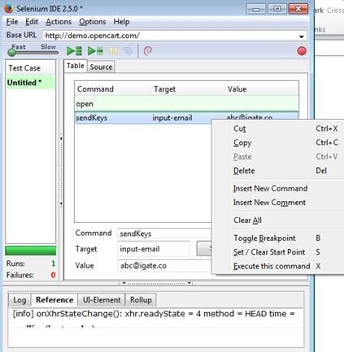
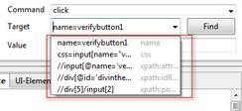
TEST AUTOMATION & ADVANCED SELENIUM LAB BOOK
Lab Demo 2: Learning Selenium IDE (Modifications)
Goals | Understand the process of further modifications and validations in automation testing of a web application on Selenium IDE Learn to manage document spacing
Time | 60 minutes
Basic URL: http://demo.opencart.com/
Follow the steps from Lab Demo 1
In order to add new command, go to the command where the new command needs to be added and then do right click , click on ‘Insert New Command’
3. ‘Command’ dropdown provides options/ keywords to perform the operation

Slide 8
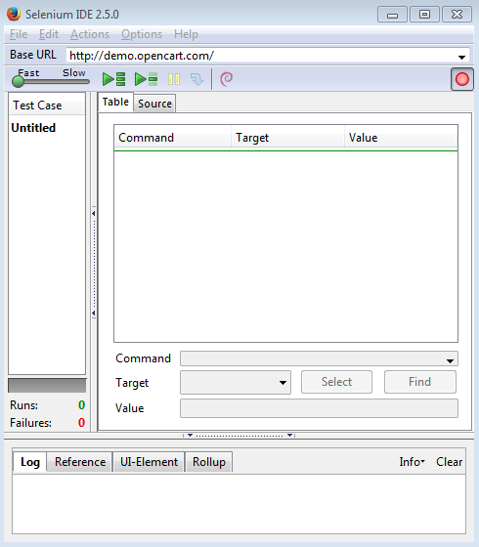
TEST AUTOMATION & ADVANCED SELENIUM LAB BOOK
Lab Demo 3: Learning Selenium IDE(Basic Flow)
Goals | Understand the basic process of automation testing of a web application in Selenium IDE Learn to manage document spacing
Time | 60 minutes
Basic URL: http://demo.opencart.com/
Open the URL on Firefox
Start recording on Selenium IDE
Go to 'Desktops' tab
Click on 'Mac'
Select 'Name(A-Z)' from the 'Sort By' dropdown
Click on 'Add to Cart' button
Stop the recording on Selenium IDE
Playback the whole test case

Slide 9
TEST AUTOMATION & ADVANCED SELENIUM LAB BOOK
Lab Demo 4: Learning Selenium IDE(Performing
Validations)
Goals | Understand the process of automation testing of a web application Learn to manage document spacing
Time | 60 minutes
Basic URL: http://demo.opencart.com/
Open the URL on Firefox
Start recording on Selenium IDE
Verify title of the page
Go to 'Desktops' tab
Click on 'Mac'
Select 'Name(A-Z)' from the 'Sort By' dropdown
Click on 'Add to Cart' button
Enter ‘Mobile’ in ‘Search’ text box and click on ‘Search’ button
Wait for page to load
Clear the text from ‘Search Criteria’ text box
Click on ‘Search in product descriptions’ check box and click on ‘Search’ button
Stop the recording on Selenium IDE
Add the step after Step 5 where verify the 'Mac' heading
Change the value from ‘Mobile’ to ‘Monitors’
Save the test case
Playback the whole test case.
Playback set by step
Add the step after Click on 'Mac' where verify the 'Mac' heading
Save the test case
Export the test case as 'Java/JUnit/webDriver'
Run the whole Test case and check the 'Pass' Status
Create another test case with the same flow
Create the test suite for the above test cases

Slide 10
TEST AUTOMATION & ADVANCED SELENIUM LAB BOOK
Lab Demo 5: Create a new account (using Selenium
Webdriver)
Goals | Understanding the scenario from end to end and automating the same Analyze the requirement and perform validations accordingly
Time | 120 minutes
Basic URL: http://demo.opencart.com/
Please ensure that the variables have to be defined before it is being used. Part 1: Launch Application
Launch the URL on Firefox
Verify 'Title' of the page
Click on 'My Account' dropdown
Select 'Register' from dropdown
‘Register Account’ page will open up, verify the heading ‘Register Account’
Click on 'Continue' button at the bottom of the page
Verify warning message 'Warning: You must agree to the Privacy Policy!'
Automate and validate the different sections of ‘Register Account’ page: Part 2: For 'Your Personal Details'
Enter data in 'First Name' text box
Verify if 33 characters can be entered in 'First Name' text box by clicking on 'Continue' button.
If not, verify error message.
Enter data in 'Last Name' text box
Verify if 33 characters can be entered in 'First Name' text box by clicking on 'Continue' button.
If not, verify error message.
Enter valid 'E-mail'.
Enter 'Telephone' which must be between 3 and 32 characters.
Part 3: For 'Your Address'
Enter 'Address 1' which should contain characters between 3 and 128
Enter 'City' which should contain characters between 2 and 128
Enter 'Post Code' which should contain characters between 2 and 10

Slide 11
TEST AUTOMATION & ADVANCED SELENIUM LAB BOOK
Select 'India' from 'Country' Dropdown
Select 'Region/State' from dropdown
Part 4: For 'Password'
Enter 'Password' which must be between 4 and 20 characters.
Enter 'Password Confirm'.
Part 4: For 'Newsletter'
Click on 'Yes' Radio button
Click on checkbox for 'I have read and agree to the Privacy Policy'.
Click on 'Continue' button
Verify message 'Your Account Has Been Created!'
Click on 'Continue'
Click on link 'View your order history' under 'My Orders'

Slide 12
TEST AUTOMATION & ADVANCED SELENIUM LAB BOOK
Lab Demo 6: Validations in Selenium (using Selenium
Webdriver)
Goals | Understanding the scenario from end to end and automating the same
Time | 120 minutes
Basic URL: http://demo.opencart.com/
After login on the ‘Open Cart’, create a test script following the below mentioned steps:
Login with credentials created in Lab 1
Go to 'Components' tab and click
Select 'Monitors'
Select 25 from 'Show' dropdown
Click on 'Add to cart' for the first item
Click on 'Specification' tab
Verify details present on the page
Click on 'Add to Wish list' button.
Verify message 'Success: You have added Apple Cinema 30" to your wish list!'
Enter 'Mobile' in ' Search' text box.
Click on 'Search' button
Click on 'Search in product descriptions' check box
Click on link 'HTC Touch HD' for the mobile 'HTC Touch HD'
Clear '1' from 'Qty' and enter '3'
Click on 'Add to Cart' button
Verify success message 'Success: You have added HTC Touch HD to your shopping cart!'
Click on 'View cart' button adjacent to search button
Verify Mobile name added to the cart
Click on 'Checkout' button
Click on 'My Account' dropdown
Select 'Logout' from dropdown
Verify 'Account Logout' heading
Click on 'Continue'

Slide 13
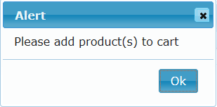
TEST AUTOMATION & ADVANCED SELENIUM LAB BOOK
Lab Demo 7: Alert and window handling (using Selenium
Webdriver)
Goals | Learning alert handling and window handling basics in selenium webdriver
Time | 120 minutes
Base URL: https://ispace.ig.capgemini.com/sitepages/index.aspx
Launch the URL
Go to 'Application' tab
Click on checkbox 'Stationery Request'
Verify the new title ‘Stationary’
On ‘Stationery’ tab, click on 'Submit to collect your Stationery >>>' link
Switch to alert as shown below.
Verify text on the alert 'Please add product(s) to cart'
Verify if 'Ok' button is present on the alert
Click on 'Ok' button
Click on ‘Photocopy’ tab, click on ‘Save Request’ button
Switch to alert and verify text ‘No changes made’
Verify if ‘Ok’ button is present
Click on ‘Ok’ button present on alert
Click on ‘Logout’ button
Close the ‘Stationery’ window

Slide 14
TEST AUTOMATION & ADVANCED SELENIUM LAB BOOK
Lab Demo 8: WebDriver with JUnit/TestNG (using
Selenium Webdriver with Junit and TestNG)
Goals | Learning how to write webdriver automation testcases using Junit and TestNG
Time | 120 minutes
Consider the flow mentioned in Lab 3 & Lab 4, complete the task using Selenium WebDriver and JUnit.
[NOTE: All the verifications should be using JUnit Assertions]
Consider the flow mentioned in Lab 3 & Lab 4, complete the task using Selenium WebDriver and TestNG.
[NOTE: All the verifications should be using TestNG Assertions. Testcases
should have proper TestNG Reporter logging as well.]
Create one TestNG test suite for both the testcases created for question number 2 along with testing.xml and execute the test suite. Provide the Reports as well.

Slide 15
TEST AUTOMATION & ADVANCED SELENIUM LAB BOOK
Lab Demo 9: Advance Selenium (Chrome Driver and IE Driver)
Goals | Learning how to write webdriver automation testcases for Chrome and IE browser
Time | 120 minutes
Consider the flow mentioned in Lab 3 & Lab 4, make necessary changes to execute the same flow on both Chrome and Internet Explorer browser.
Consider the Question number 1 and make it JUnit test case.
[NOTE: All the verifications should be using JUnit Assertions]

Slide 16
TEST AUTOMATION & ADVANCED SELENIUM LAB BOOK
Lab Demo 10: Advance Selenium (RemoteWebDriver)
Goals | Learning how execute Selenium scripts using RemoteWebDriver
Time | 120 minutes
Consider the flow mentioned in Lab 3 & Lab 4, make necessary changes to execute the same flow using RemoteWebDriver and Selenium Grid on Firefox, Chrome and Internet Explorer browser.
[NOTE: Set Platform, BrowserName and Version to DesiredCapabilities]
Consider the flow mentioned in Lab 4 and take screenshot after each steps. Save all the screenshots inside a folder called ‘Screenshots’ in the root of the Java project.

Slide 17
TEST AUTOMATION & ADVANCED SELENIUM LAB BOOK
Lab Demo 11: Advance Selenium (Page object Model and
Page Factory)
Goals | Learning how to use page object model and page factory to make the test maintenance easy
Time | 121 minutes
Consider the flow mentioned in Lab 3 & Lab 4, complete the task using page object model.
Hints : create one class for locators and other classes for Test cases.
Consider the flow mentioned in Lab 3 & Lab 4, complete the task using page object model with page factory

Slide 18
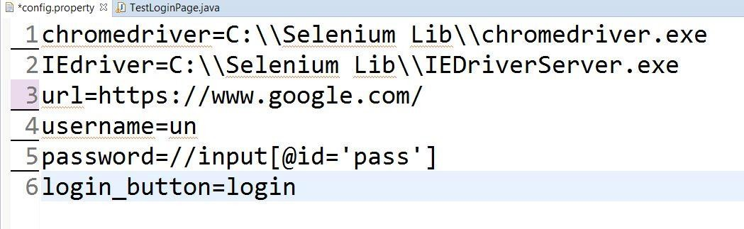
TEST AUTOMATION & ADVANCED SELENIUM LAB BOOK
Lab Demo 12: Advance Selenium (Object Repository using
Properties File)
Goals | Learning how to create Object Repository using Properties File
Time | 122 minutes
Consider the flow mentioned in Lab 4, complete the task using properties file object repository.
Steps to create Properties File in eclipse
Create java project
Add Selenium webdriver jar file
Right click on project and create folder – “configuration”
Right click on configuration folder -> New -> File and give a file name – “config.property”
Enter keys and values in property file
Find below example properties file

Slide 19
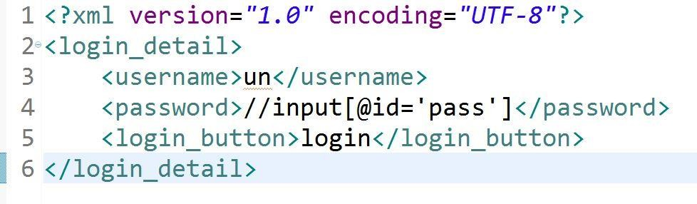
TEST AUTOMATION & ADVANCED SELENIUM LAB BOOK
Lab Demo 13: Advance Selenium (Object Repository using XML file)
Goals | Learning how to create Object repository using XML file
Time | 123 minutes
Consider the flow mentioned in Lab 4, complete the task using properties file object repository.
Steps to create XML file in eclipse
Create Java project
Right click on project -> New -> Other -> XML - XML File 3.Name xml file - ObjectRepository.XML
Write XML code
Import jaxen.jar and dom4j-1.6.jar file in eclipse to read XML file
Find below example for XML file

Slide 20
TEST AUTOMATION & ADVANCED SELENIUM LAB BOOK
Lab Demo 14: Advance Selenium (Parametrization using
Excel Apache POI)
Goals | Learning how to use parameterization using Excel and Apache POI lib., to achieve regression testing.
Time | 60 minutes
Basic URL: http://demo.opencart.com/
1. Create “UserDetails.xls” file with First_Name, Last_Name, E-Mail, Telephone, Password and Password Confirm columns and insert data in the sheet.
Follow below flow to write Selenium Webdriver script
Open the URL on Firefox/chrome/IE browser
Verify if the title “Your store” of the application is correct
Click on “My Account” menu option
Select “Register” option
Verify the text present on web page as “Register account
Enter all the details in the First name, Last Name, E-Mail, Telephone, Password, Password Confirm from the excel sheet (UserDetails.xls)
Select “I have read and agree to the Privacy Policy” check box
Click on “Continue” button
Verify the acknowledgement message “Your Account Has Been Created”
Hint : Use Appache POI lib file to connect with excel sheet through Selenium Webdriver.

Slide 21
TEST AUTOMATION & ADVANCED SELENIUM LAB BOOK
Lab Demo 15: Advance Selenium (Parameterization using CSV file)
Goals | Learning how to use parametrization using CSV file to achieve data driven testing
Time | 60 minutes
Basic URL: http://demo.opencart.com/
1. Create “UserDetails.csv” file with First_Name, Last_Name, E-Mail, Telephone, Password, Pass_Confirm insert 2 rows of data in the CSV file.
Follow below flow to write Selenium Webdriver script
Open the URL on Firefox/chrome/IE
Verify if the title “Your store” of the application is correct
Click on “My Account” menu option
Select “Register” option
Verify the text present on web page as “Register account
Enter all the details in the First name, Last Name, E-Mail and Telephone from the CSV file (UserDetails.csv)
Select “I have read and agree to the Privacy Policy” check box
Click on “Continue” button
Verify the acknowledgement message “Your Account Has Been Created”
Note : Use notepad to create CSV file and save it with .CSv extention

Slide 22
TEST AUTOMATION & ADVANCED SELENIUM LAB BOOK
Lab Demo 16: Advance Selenium (Parameterization using
XML and Dataprovider in TestNG)
Goals | Learning how to use XML and Dataprovider annotation in TestNG to achieve parameterization
Time | 60 minutes
Basic URL: http://demo.opencart.com/
Steps to create TestNg.XML file
Create class in java project
Use @ Test annotation and create test case
Right click on class -> TestNG ->Convert to TestNG
Give the proper class name and pass the parameter in XML file
Follow below flow to write Parameterized Selenium Webdriver script using XML in TestNG
Open the URL on Firefox/chrome/IE browser
Verify if the title “Your store” of the application is correct
Click on “My Account” menu option
Select “Register” option
Verify the text present on web page as “Register account”
Enter all the details in the First name, Last Name, E-Mail, Telephone, password and password confirm fields from the excel sheet (UserDetails.xls) using TestNG
Select “I have read and agree to the Privacy Policy” check box
Click on “Continue” button
Verify the acknowledgement message “Your Account Has Been Created”
14.2 Consider above flow and insert data into the application using DataProvider annotation in TestNg
Note : Use @DataProvider(name= “UserDetails”) annotation

Slide 23
TEST AUTOMATION & ADVANCED SELENIUM LAB BOOK
Appendices
Appendix A: Selenium Standards
Key points to keep in mind:
Selenium standards help you reach the widest possible audience.
There are many technologies that are associated with HTML because they are used on web pages or in conjunction with HTML.
For each of the above, please follow coding conventions specified by that technology.
Sometimes you are going to have to break rules and use non-standard syntax for good reason. Try to keep this to the minimum.
How to follow Selenium standards:
See the W3C site for more information on locator types and keyword statements.
The important thing to remember is that proper keywords are essential to assist validation software in checking your document.
Use Selenium IDE to find the locators for the elements. Refer to W3C for technical and syntax information.
Always use the comments with the codes for proper understanding.

